Slide 1
Lightboard Template

Slide 2
If you’re writing on the board leave room on the slide for it*
*Erasing takes time, don’t lecture while erasing

Slide 3
Leave room for you on the slide

Slide 4
Interact with the content on the slide*
*Video can be inserted into presentations with or without sound

Slide 5
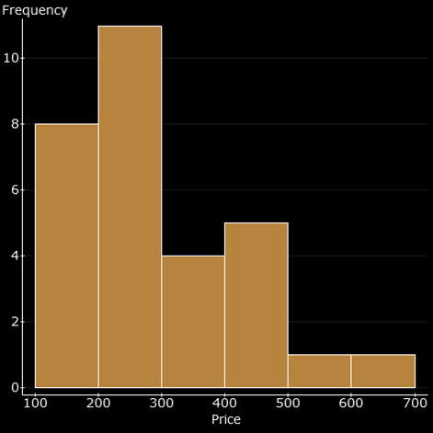
The background must be black, use font colors that pop*
*if you’re using the green screen don’t use a green color font
Use Graphics with Color
Write text in boxes with a color background

Slide 6
What to wear or not wear?
Wear solids colors (but not white).
If you’re using the green screen, don’t wear patterned clothing.
If you’re using the green screen, don’t wear green.

